Slide 1



HackTrix’24
Team Name: Binary Bandits
Members Name: Shaurya Singh Srinet
Shounak Chandra
Parth Galhotra
Charvi Jain

Slide 2

Introduction
Project Overview
Welcome to Sign Translate, where we're revolutionizing sign language communication with cutting-edge real-time translation models. Sign Translate aims to bridge the communication gap between the deaf and hearing communities, offering seamless sign language translation on both desktop and mobile platforms.

Slide 3
Sign Translate serves individuals who are deaf or hard of hearing, along with educators, interpreters, and businesses focused on accessibility. It facilitates seamless communication across sign languages and spoken languages, fostering inclusivity in diverse settings.
Our platform addresses the global need for effective communication solutions, catering to users worldwide. Whether in urban hubs or remote regions, Sign Translate offers accessible tools for overcoming linguistic barriers, ensuring communication without boundaries.
By providing reliable and user-friendly sign language translation, we empower individuals and organizations to communicate confidently and efficiently. Sign Translate fosters a world where language differences are no longer obstacles, enabling meaningful interactions across cultures and communities.
Target Users and market selection

Slide 4

Problems
Title: Enhancing Accessibility Through Sign Language Translation
Explain
Despite the widespread use of sign language, many individuals face barriers in communication due to the lack of real-time translation solutions. Traditional methods of sign language interpretation can be time-consuming and resource-intensive, hindering effective communication and accessibility for the deaf community.

Slide 5

Solution : Sign Translate
Proposed solution
(Solution, Key features, Technical Architect)
Sign Language Production: Converts spoken language audio into sign language through advanced translation models.
Sign Language Translation: Translates sign language captured through video into spoken language, facilitating communication between deaf and hearing individuals.
Technical Architecture: Utilizes state-of-the-art technologies such as Human GAN, SignWriting, and Pose Sequence analysis to ensure accurate translation and seamless user experience.

Slide 6
Challenges and Key Learning (Technical challenges, Solutions & workaround, Key learnings)
Technical Challenges: Overcoming the complexities of accurately translating between spoken and sign languages in real-time.
Solutions & Workarounds: Iterative development, rigorous testing, and collaboration with the deaf community to refine translation algorithms and enhance accuracy.
Key Learnings: Importance of user feedback, continuous improvement, and accessibility-driven design principles in developing effective communication tools for the deaf community.

Slide 7
Future work
(Potential features, plans for scaling)
Potential Features: Integration of additional sign languages, enhancement of translation accuracy, and development of mobile applications for on-the-go accessibility.
Plans for Scaling: Partnering with educational institutions, government agencies, and technology companies to expand accessibility initiatives and reach a broader audience globally.
Explain
1. Integration of Additional Sign Languages:Expand language support to include a broader range of sign languages, ensuring accessibility for diverse communities worldwide.
2. Enhancement of Translation Accuracy:Invest in research and development to improve the accuracy and precision of sign language translation algorithms, providing more reliable communication for users.
3. Mobile Application Development: Create mobile applications for iOS and Android platforms, enabling on-the-go accessibility and convenience for users wherever they are.
4. Community Engagement and Feedback: Foster ongoing collaboration with the deaf community to gather feedback, insights, and suggestions for improving Sign Translate's functionality and user experience.
5. Partnerships and Expansion: Forge strategic partnerships with educational institutions, government agencies, and technology companies to scale accessibility initiatives and reach a broader audience globally.

Slide 8
⁠Business Model and Monetization
Sign Translate operates on a freemium model, offering basic translation services for free, while premium features and enterprise solutions are available on a subscription basis. This approach ensures accessibility to essential communication tools while providing value-added services to users and organizations with specific needs.
Explain
1. Freemium Model: Basic translation services are offered for free to attract users and promote adoption.
2. Subscription Plans: Premium features, such as advanced translation accuracy, offline access, and customization options, are available through subscription plans tailored to individual users, educational institutions, and businesses.
3. Enterprise Solutions: Customized enterprise solutions are offered to organizations, providing scalable, secure, and tailored translation services to meet specific business needs.
4. Partnerships and Sponsorships: Explore partnerships and sponsorship opportunities with organizations aligned with our mission of promoting accessibility and inclusivity, generating additional revenue streams and expanding our reach.

Slide 9
Strategy
1. Community Engagement: Engage with the deaf community and advocacy groups to ensure that Sign Translate meets the needs and preferences of its users.
2. Education and Awareness: Collaborate with educational institutions and government agencies to raise awareness about the importance of accessibility and promote the adoption of Sign Translate as a communication tool.
3. Product Development: Continuously innovate and improve Sign Translate's features and functionality based on user feedback, technological advancements, and market trends.
4. Market Expansion: Expand Sign Translate's reach globally by entering new markets, forging strategic partnerships, and localizing the platform to cater to diverse linguistic and cultural needs.
Conclusion
(Recap & acknowledgments)
Sign Translate represents a significant step forward in enhancing accessibility and inclusivity for the deaf community. By leveraging cutting-edge technologies and collaborative partnerships, we're dedicated to breaking down communication barriers and empowering individuals to connect, communicate, and thrive in a diverse world. Join us on our journey to revolutionize sign language communication and create a more inclusive society for all.

Slide 10
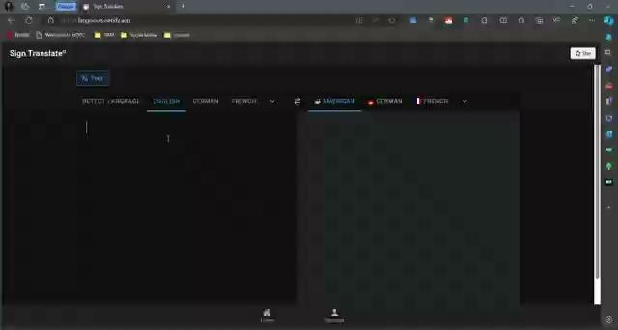
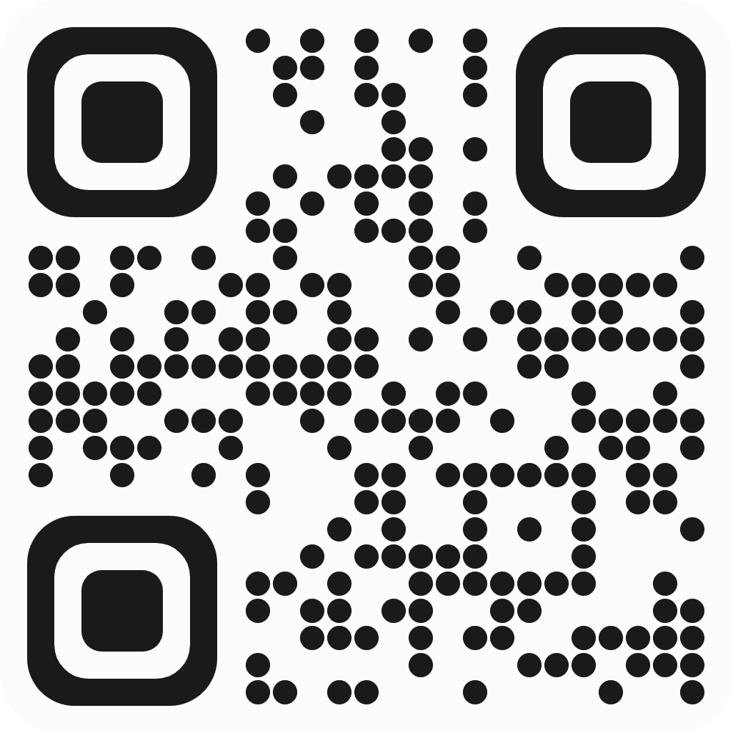
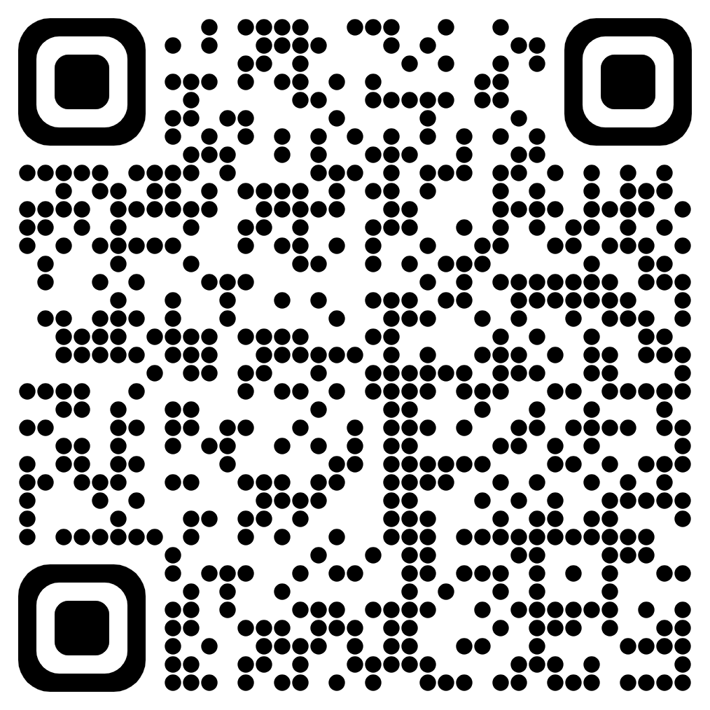
Working Prototype
To access our prototype on web, hop on to https://langnexus.netlify.app/ To download the app, go to https://drive.google.com/file/d/1TqbCkFcDkic60P4MF98omJnykUPuvNA-/view?usp=sharing
Demo Video
Or scan the QR code below
for Website
for App

